Slide 1

Cohort Differences in Gun Use and Exposure to Gun Violence in a 25-year Study of Chicago Children
Charles C. Lanfear
Robert J. Sampson
David S. Kirk
Rebecca Bucci

Slide 2
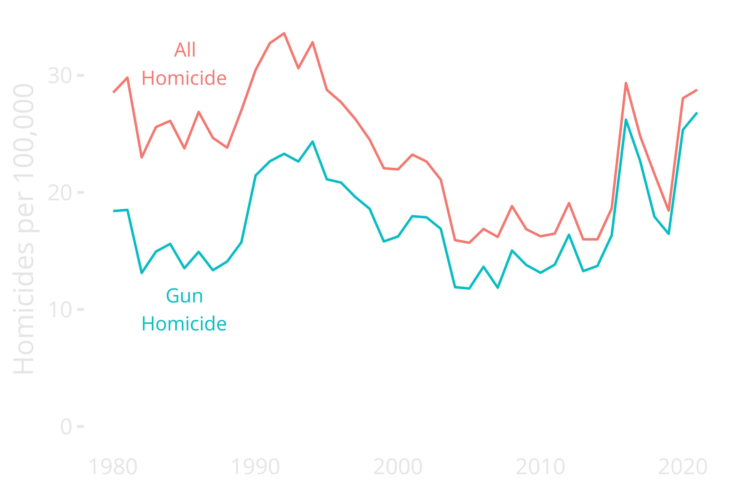
Notes:
Enormous variation in homicide; early 1990s peak was double the period 2005-2015
Resurgence since 2017
Even during low periods, this is ten or more times the homicide rate of major European cities

Slide 3

Questions
To what extent do historical conditions and macro-social change influence the likelihood of individuals…
using guns?
being exposed to gun violence?
Notes:
We’ll be focusing mostly on cohort here; last session focused on race and sex.

Slide 4



Slide 5

PHDCN (1995-2002)
Longitudinal study of 6,200 children
7 cohorts in 1995: 0 (infant), 3, 6, 9, 12, 15, and 18
Probability samples from 80 neighbourhoods
Stratified by race and social class
Three waves, 1995-2002
Parents/caretaker and child assessments
75-78% response rates
Community surveys of 343 neighborhoods
1995 and 2002-2003

Slide 6
PHDCN+ Wave 4 (2011-2012)
N = 1,057, nationwide field effort (funded by MacArthur Foundation)
Random sample of cohorts 0, 9, 12, and 15
63% response rate
Diverse sample:
40% Latino/Hispanic
37% Black
19% White

Slide 7
PHDCN+ Wave 5 (May-Oct 2021)
N = 682, multi-mode survey: web, phone, F2F
66% response rate
Official criminal justice histories, 1995-2020
Planned through 2023

Slide 8
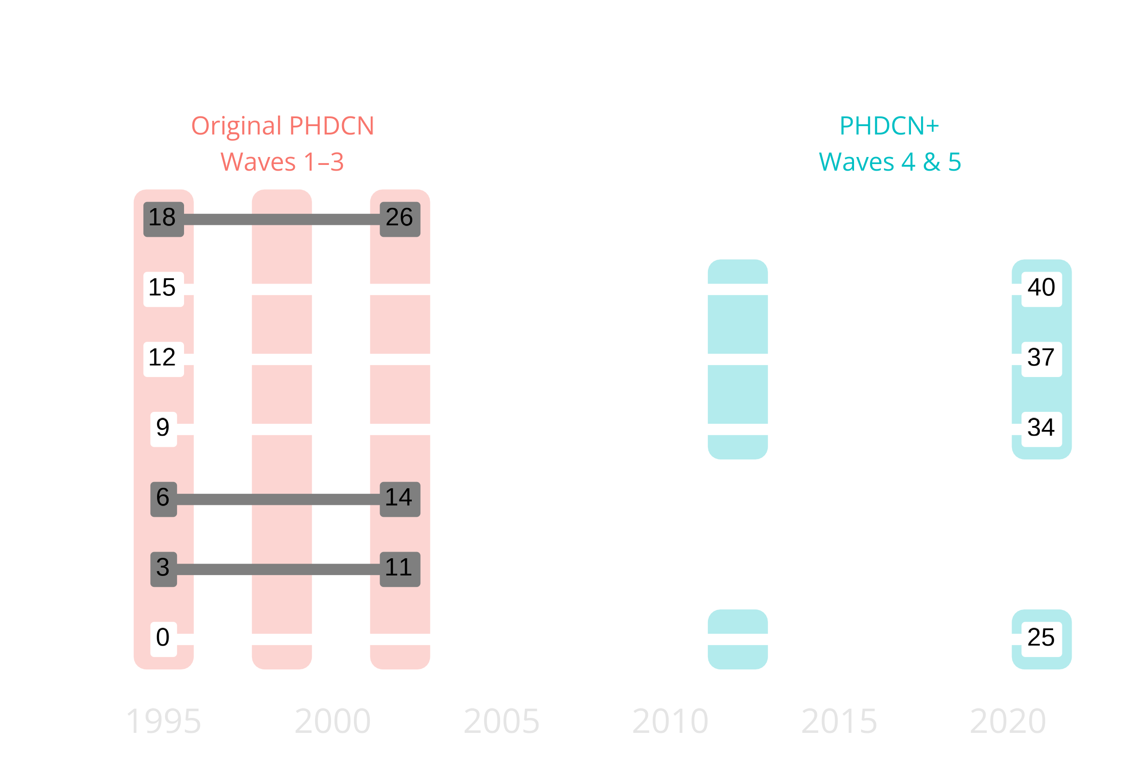
Notes:
PHDCN+ covers much longer time period than original PHDCN: Age 0 to 40, 25 years within each cohort
Well past peak criminal involvement and exposure ages

Slide 9
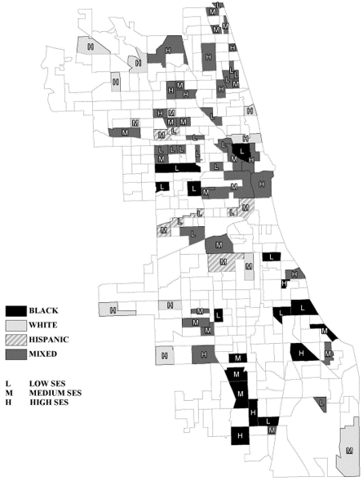
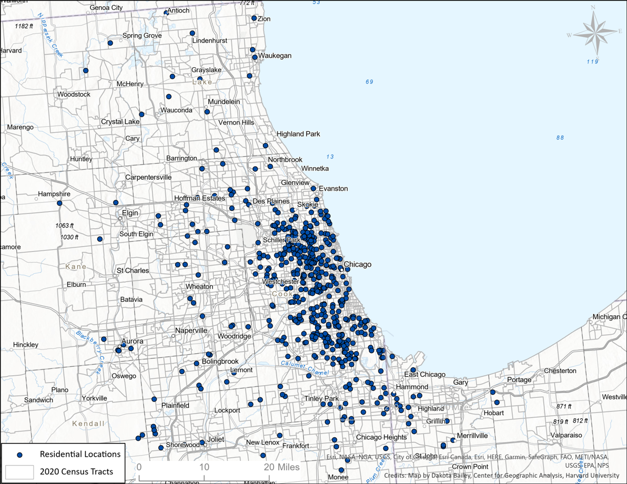

Slide 10
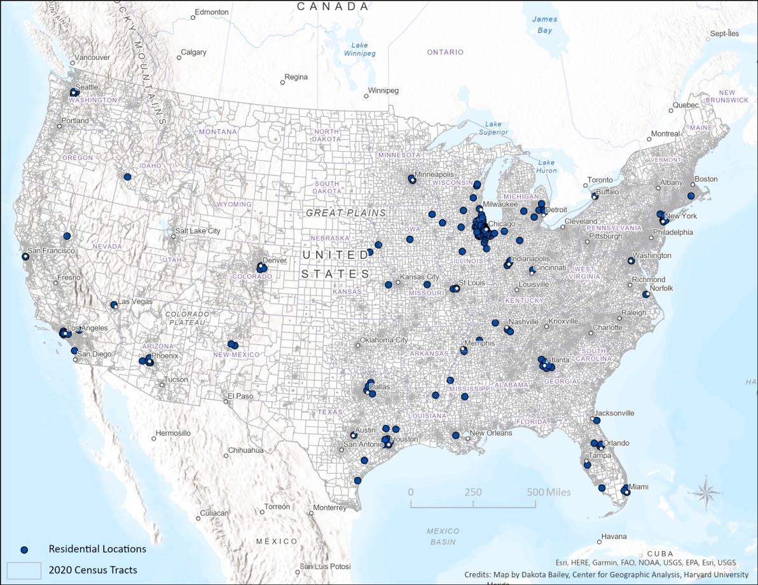

Slide 11
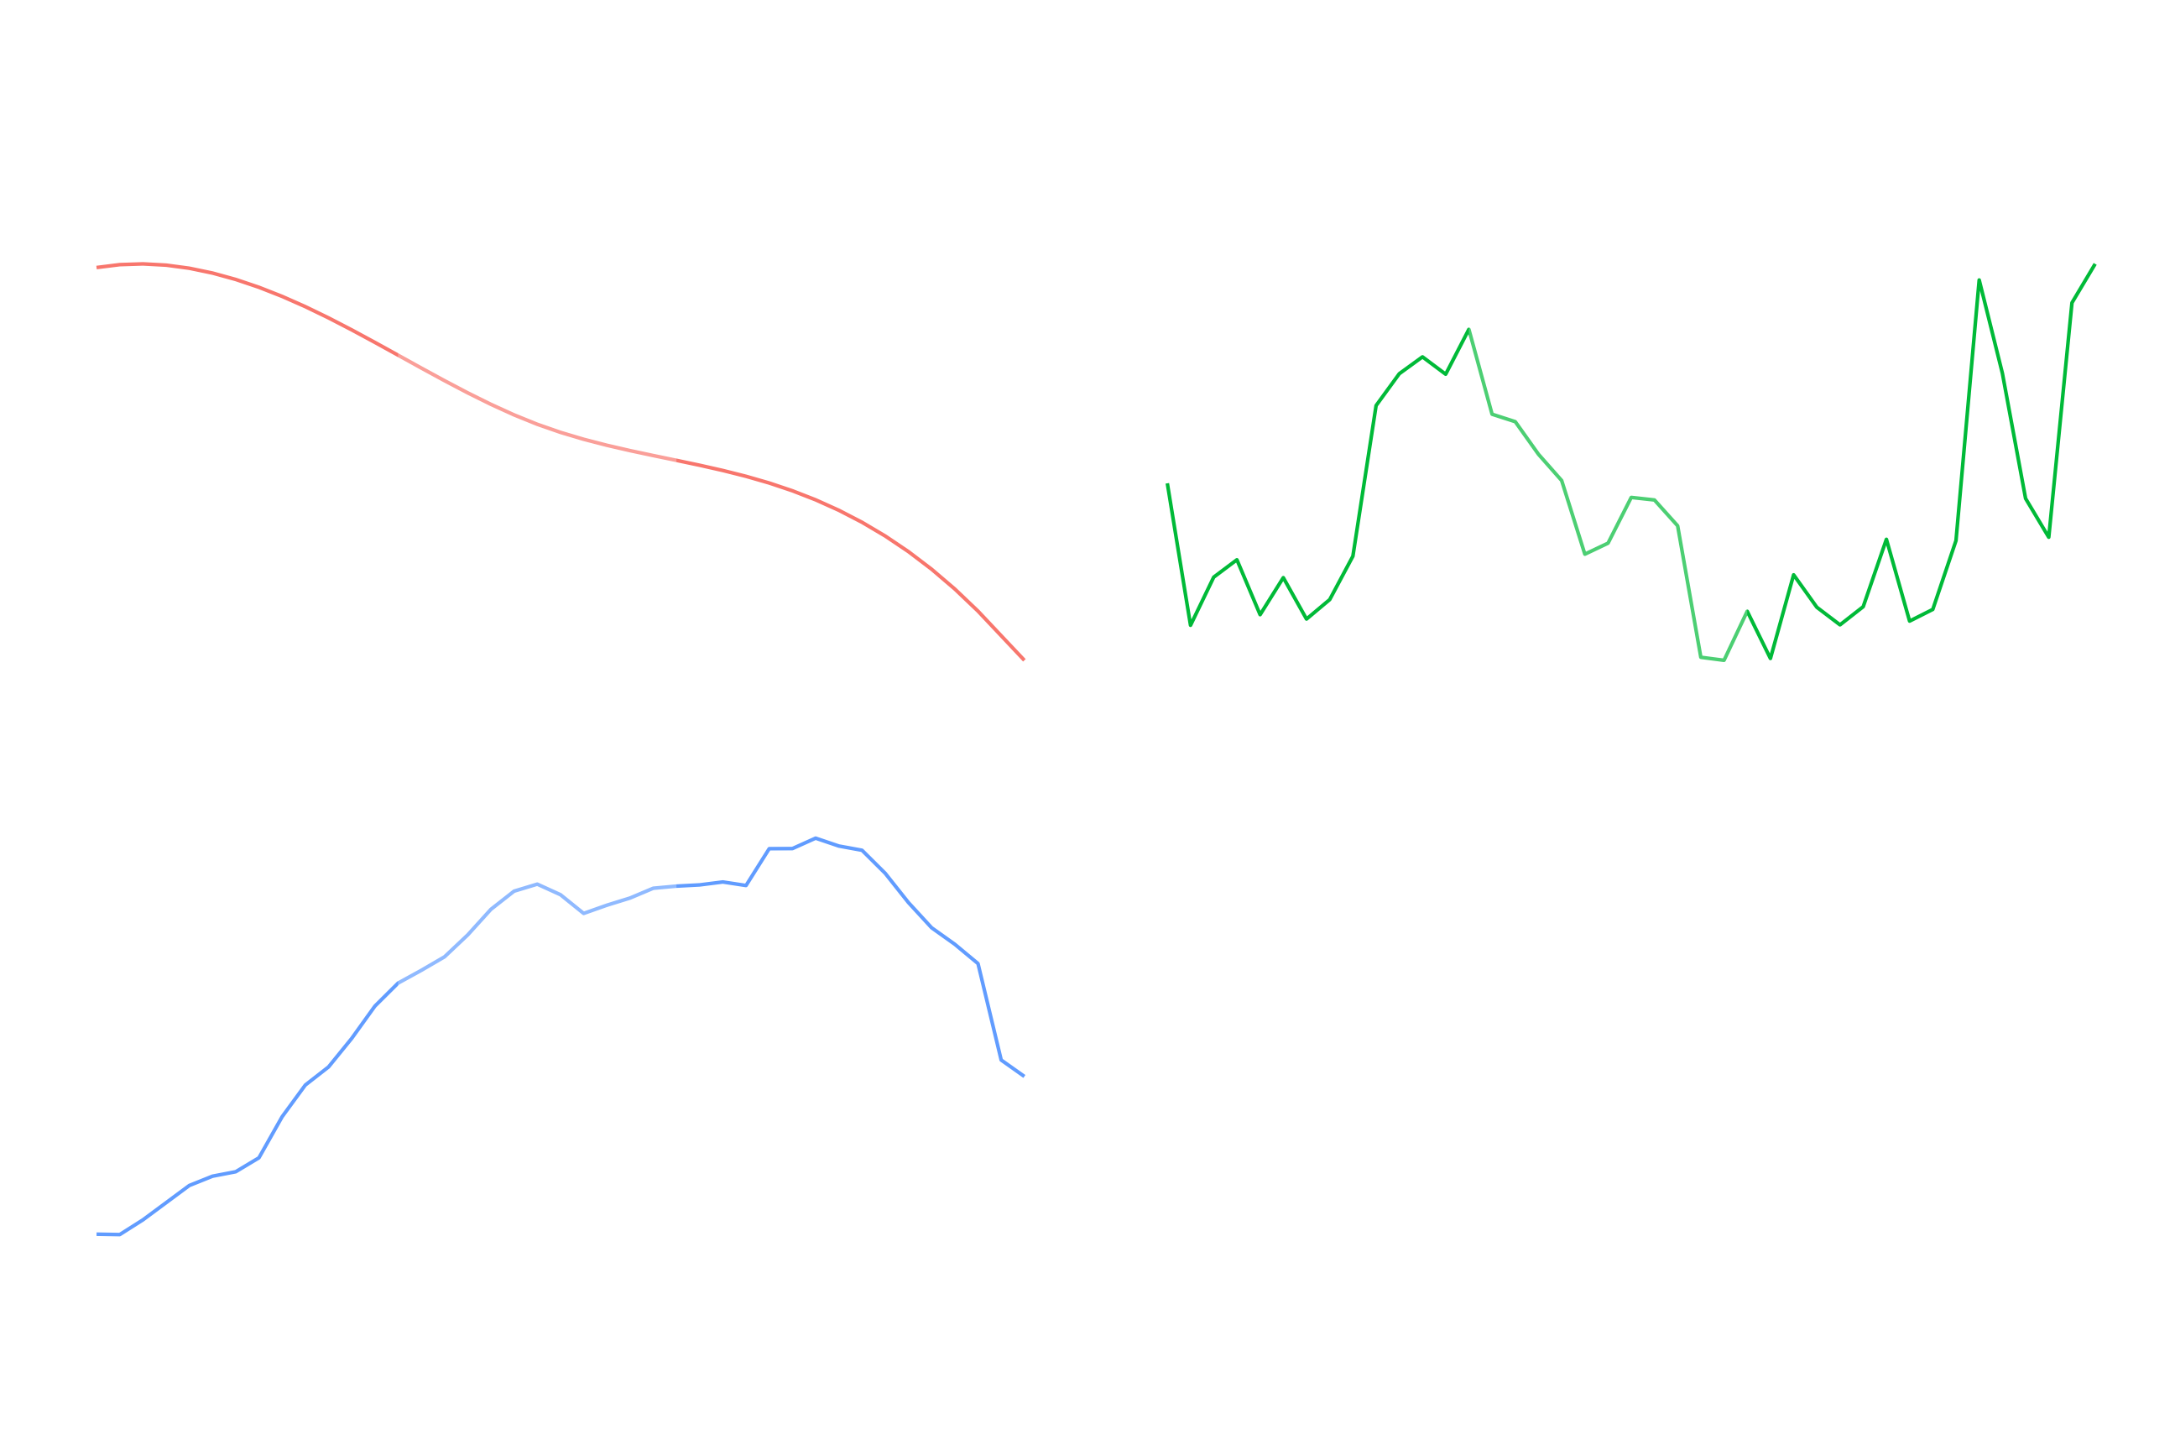
Notes:
Align by age instead of year—see age-specific contexts for gun violence, incarceration, disadvantage.
Age 13 to 25 highlighted as peak risk period—different patterns for all cohorts

Slide 12
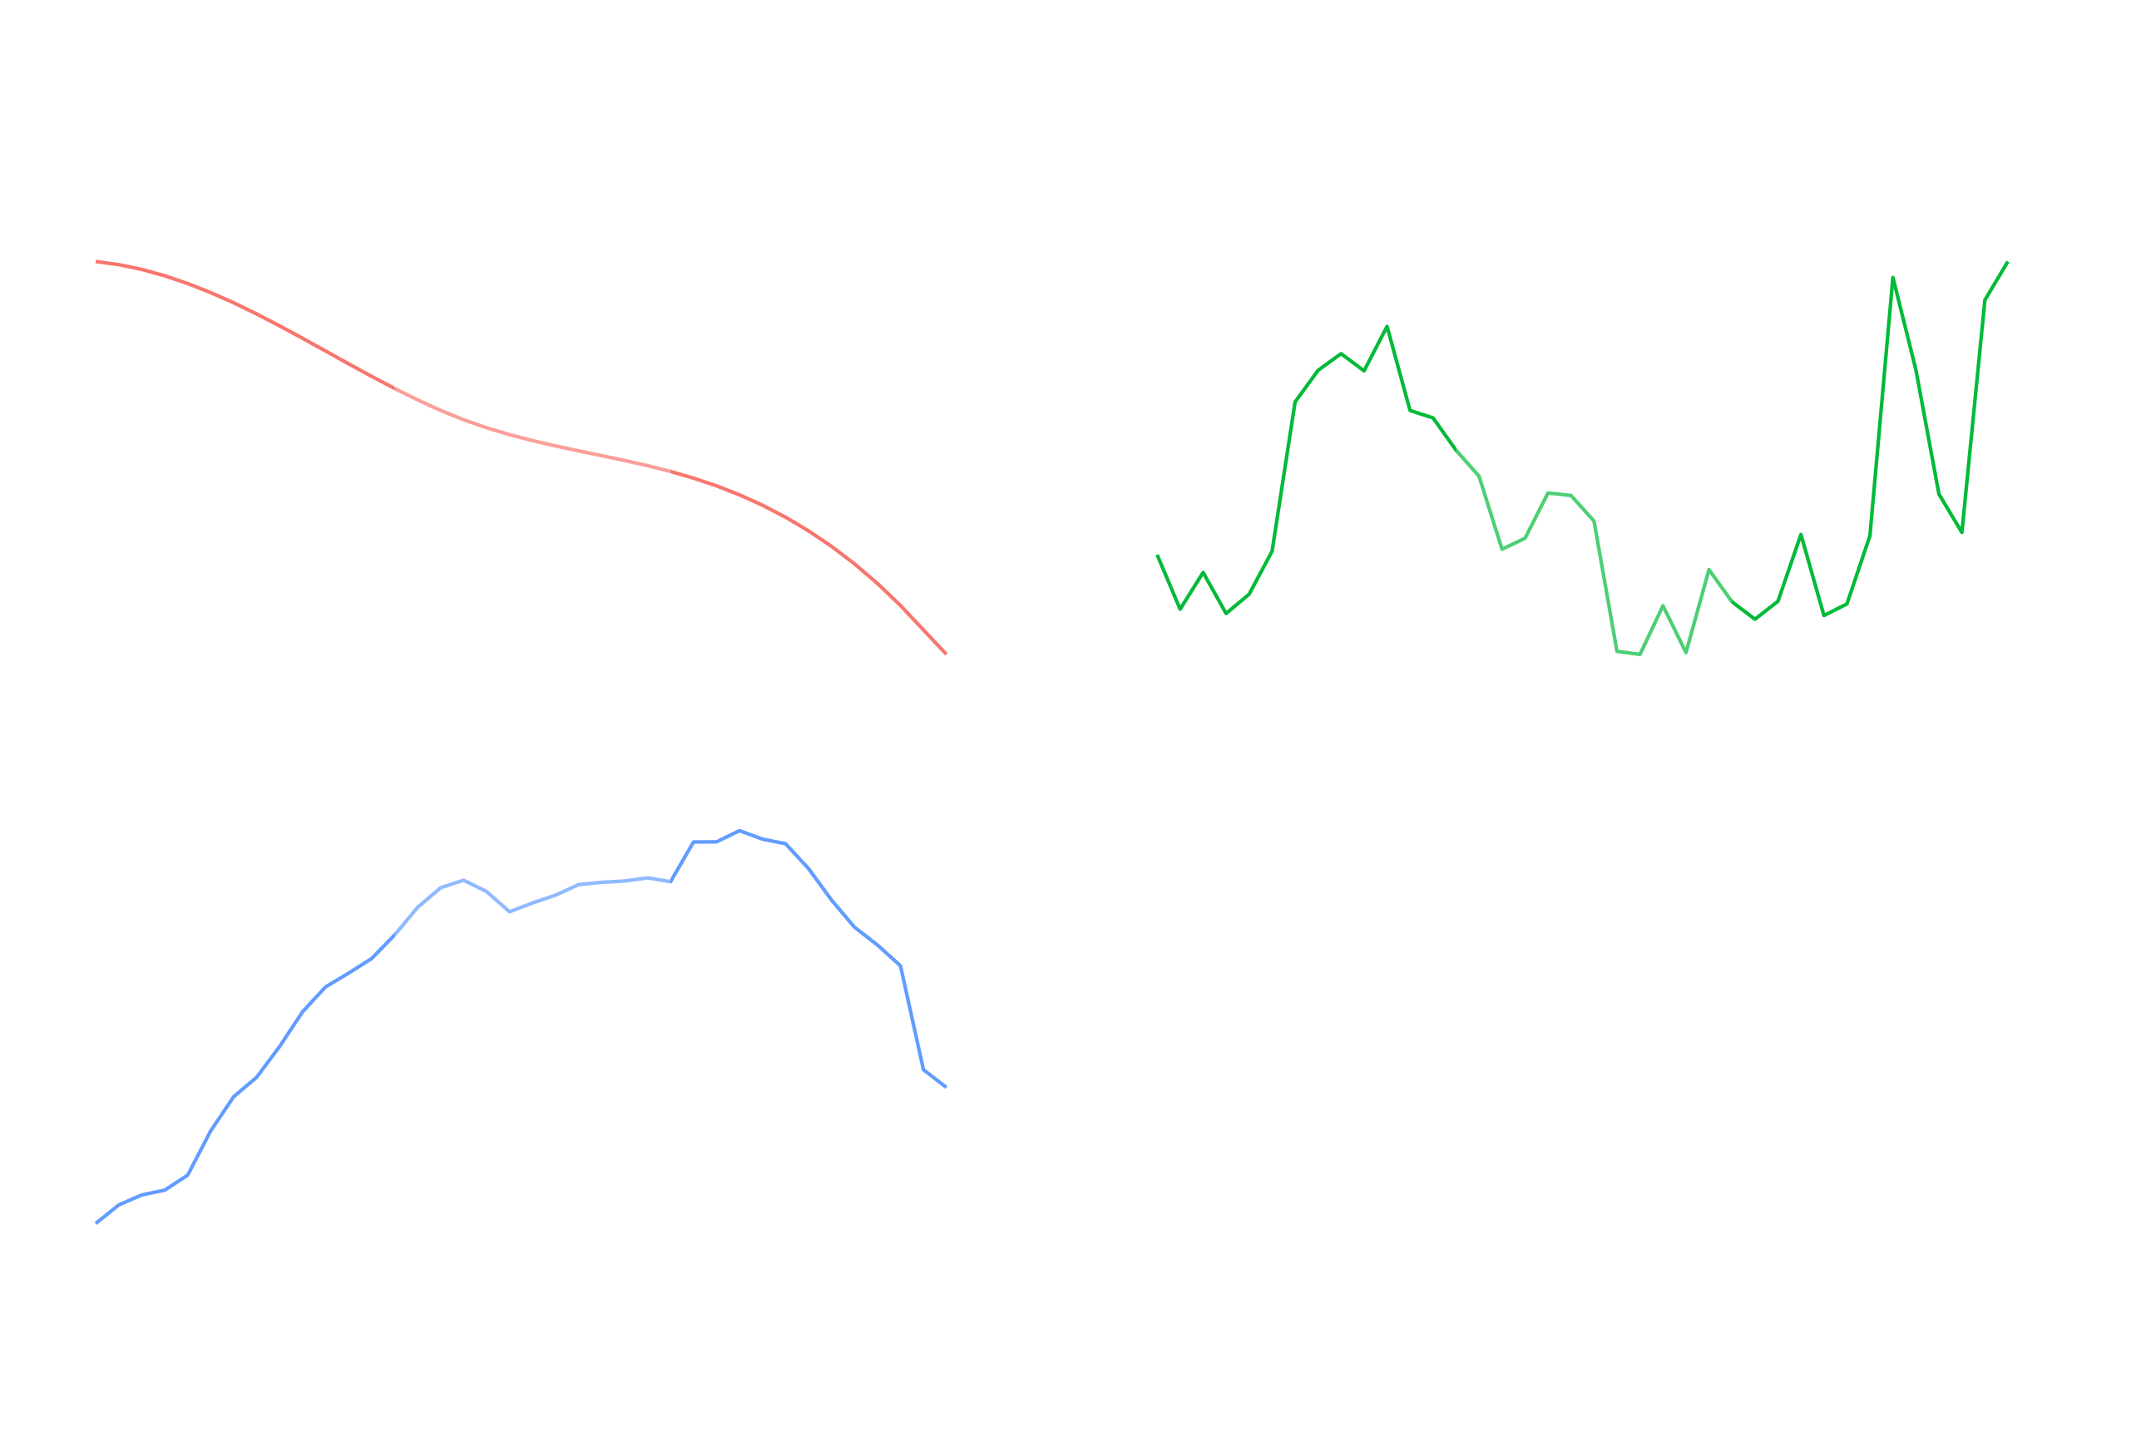

Slide 13
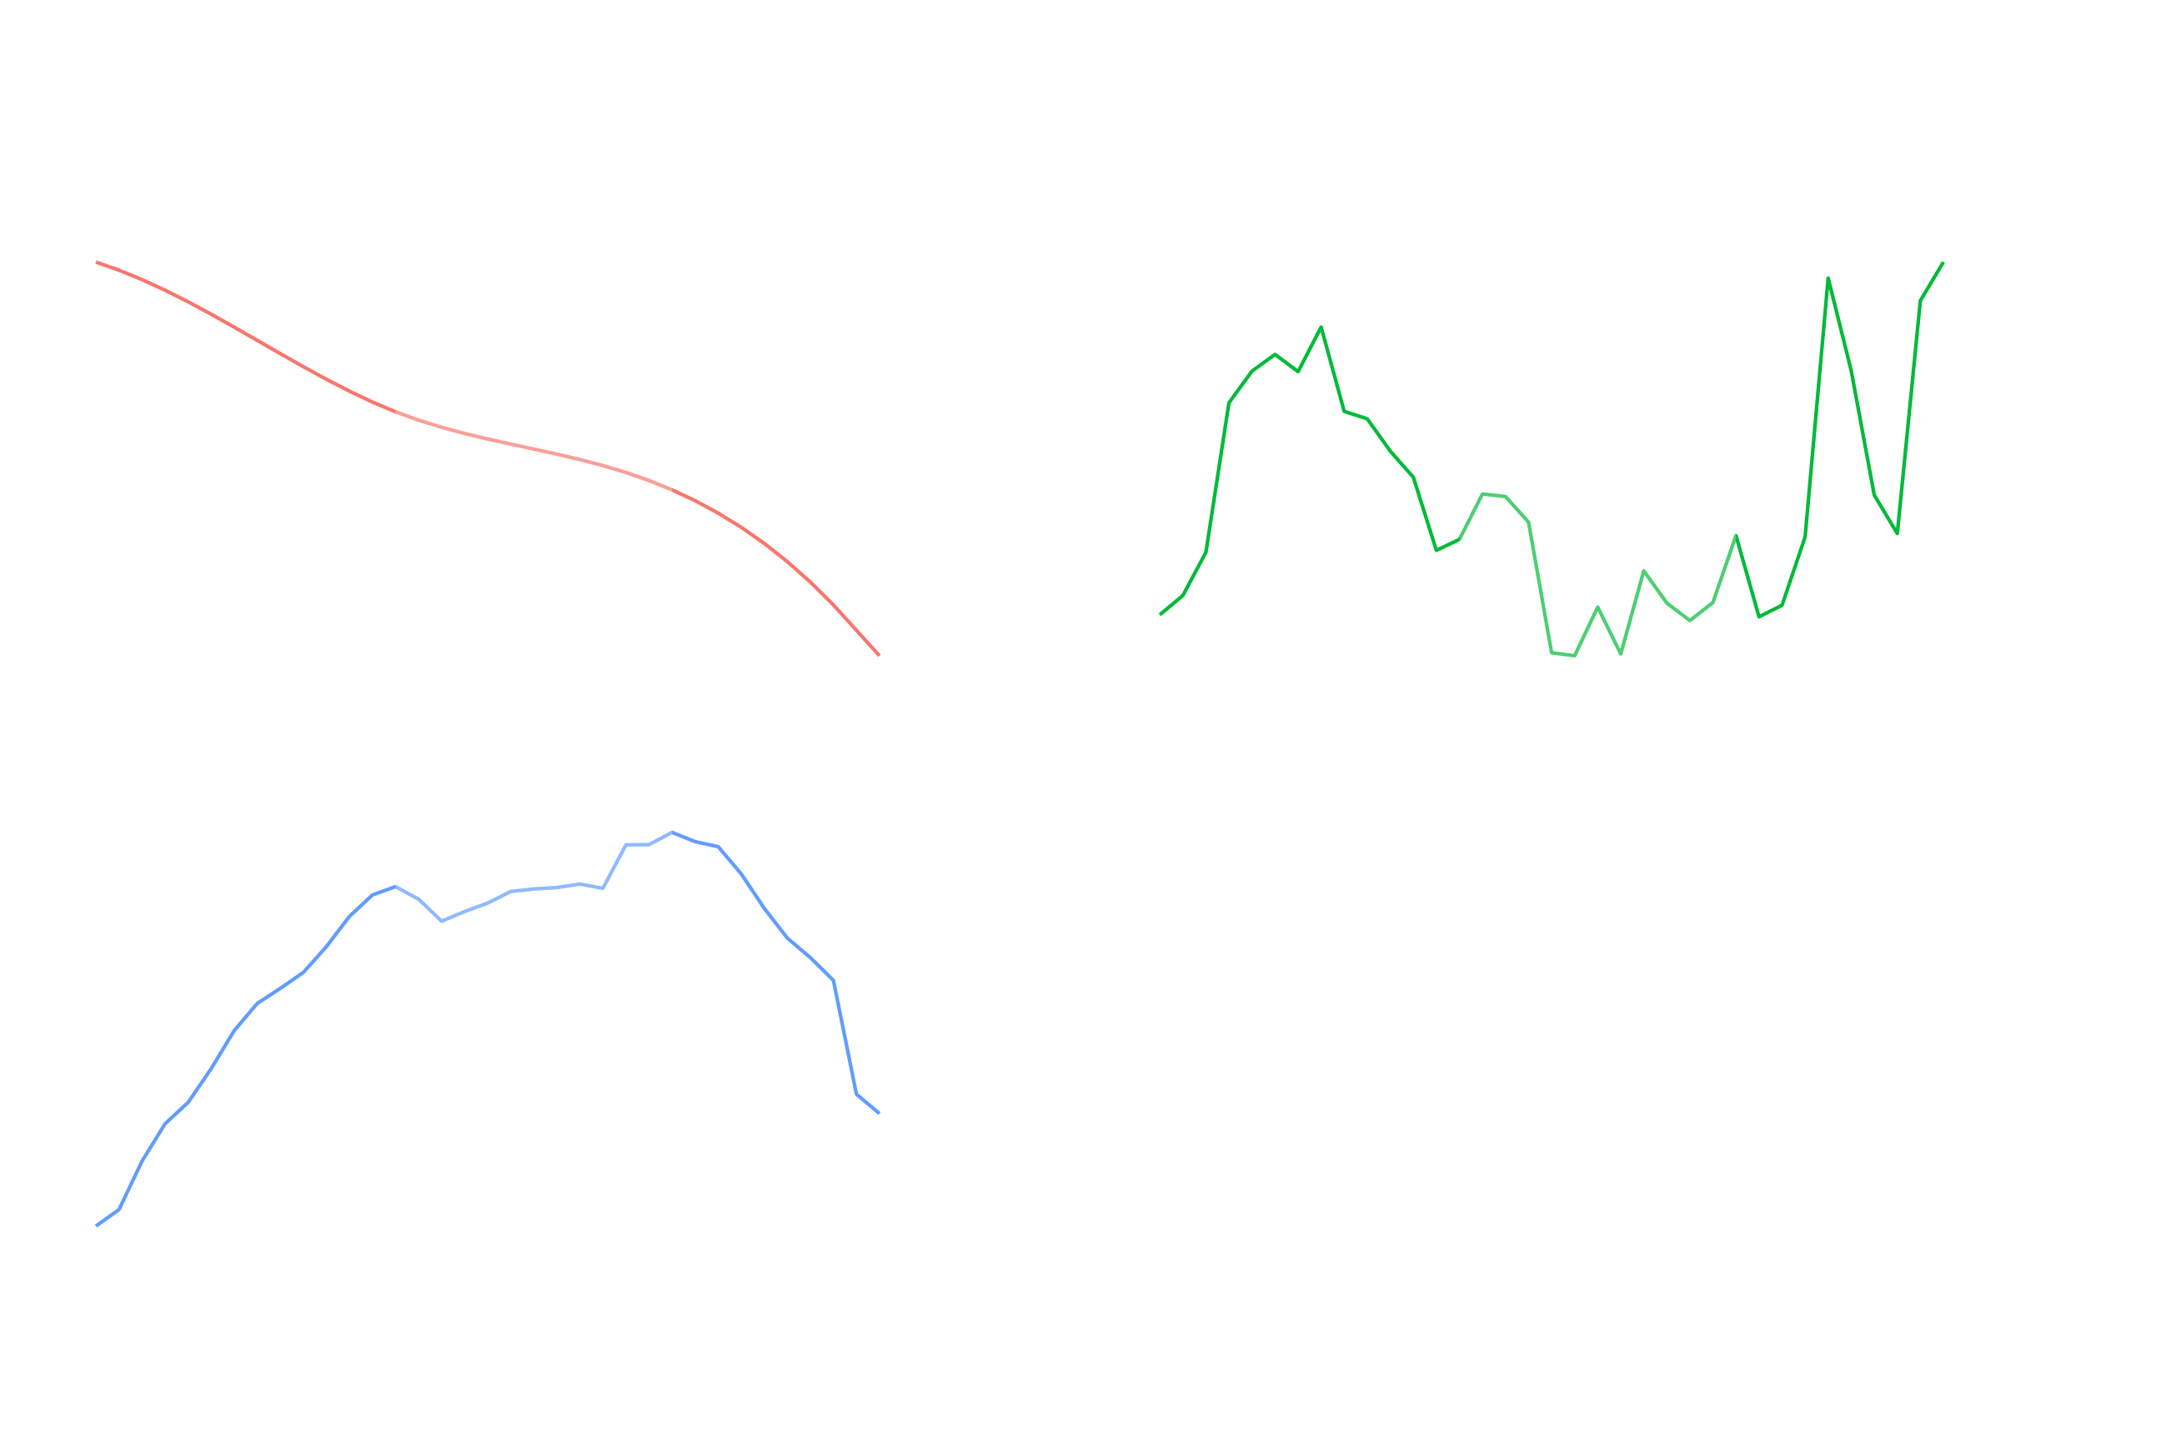

Slide 14
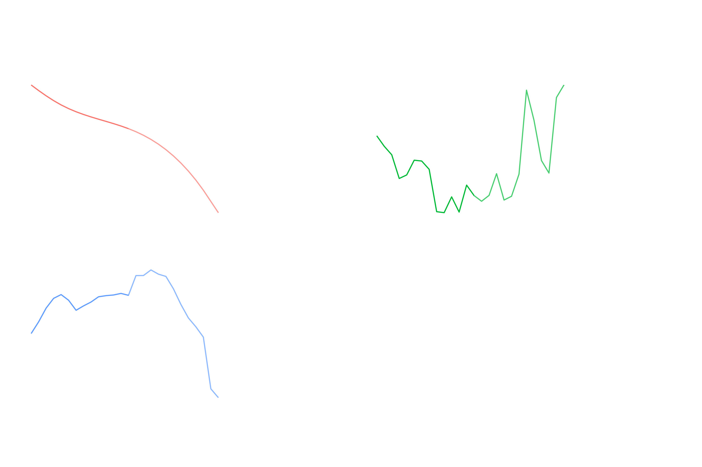

Slide 15

Lifecourse Gun Use and Exposures to Gun Violence

Slide 16

Measures
Has the respondent…
ever been shot?
ever seen someone else get shot?
ever carried a concealed gun?
ever used a gun for protection?

Slide 17
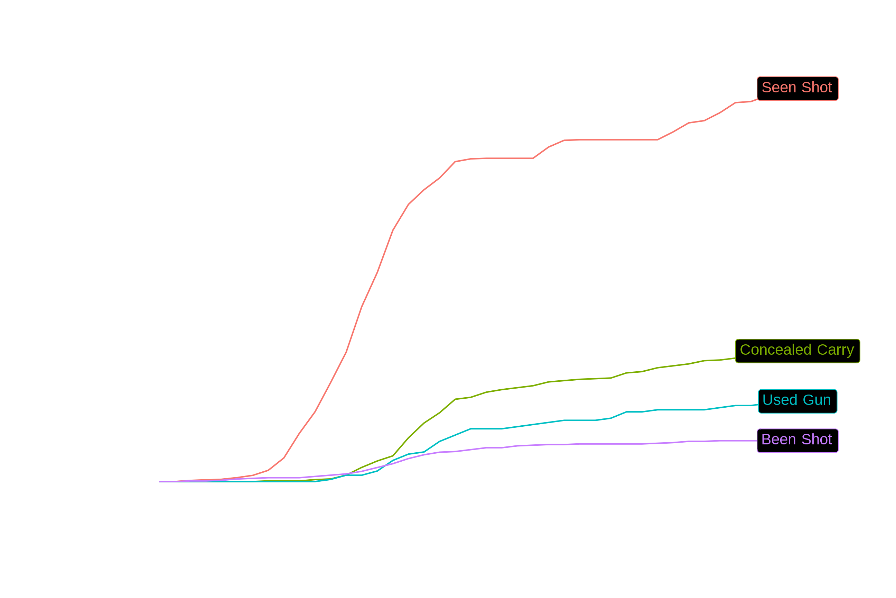

Slide 18
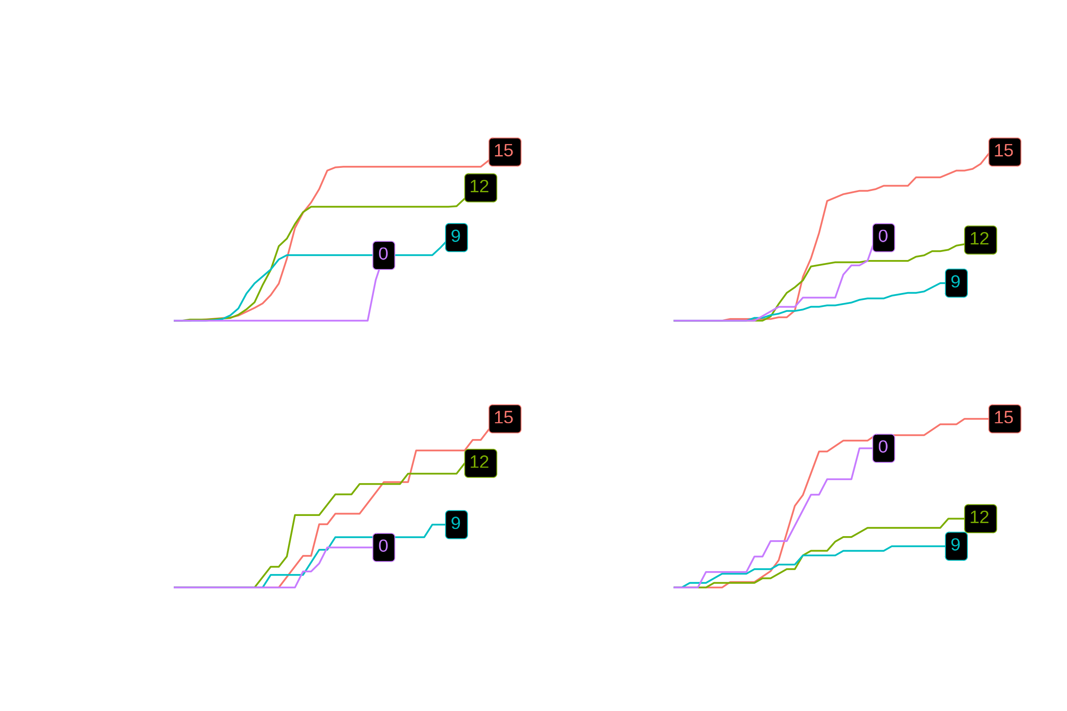

Slide 19


Slide 20
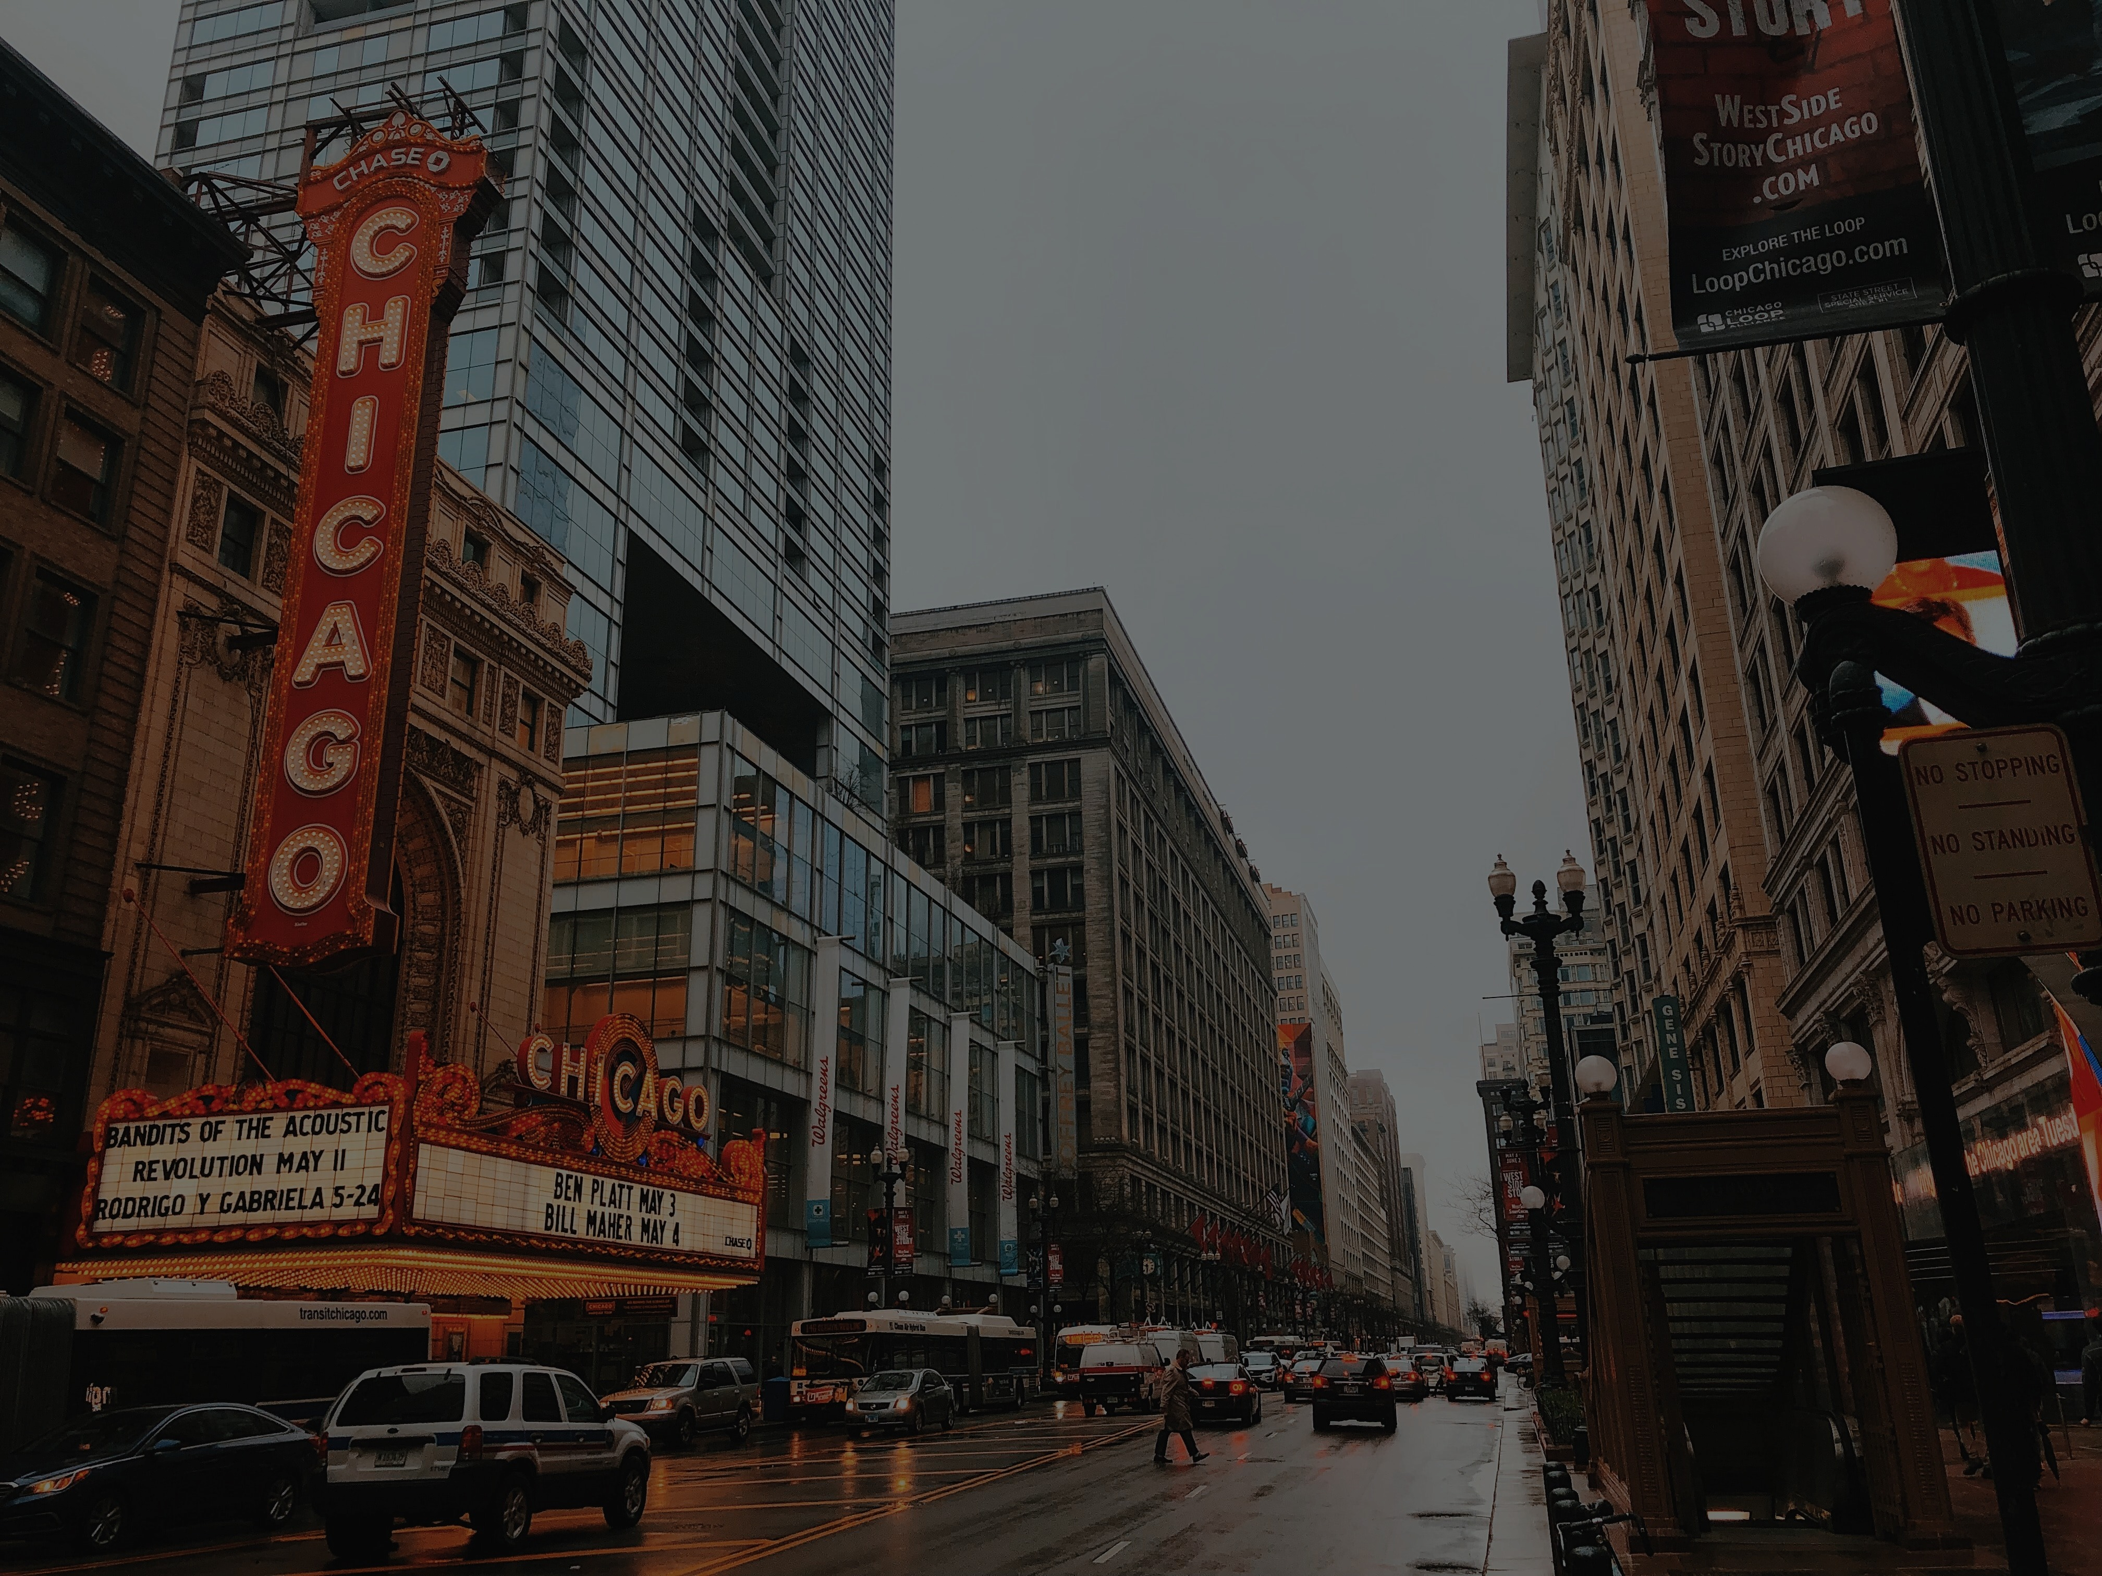
Future Plans
Period effects, social change, and exposure to violence
Life course of victimization through mid-adulthood
Reproduction of gun violence
Long-term causal consequences of exposure to violence for health and well-being
The extent and consequences of exposure to police brutality
Residential attainment in levels of gun violence in 2021

Slide 21
Feedback and Questions
Contact:
Charles C. Lanfear Institute of Criminology University of Cambridge
See more about the PHDCN:
https://sites.harvard.edu/phdcn/

Slide 22

References
Sampson, Kirk, & Bucci. 2022. “Cohort Profile: Project on Human Development in Chicago Neighborhoods and Its Additions (PHDCN+).” Journal of Developmental and Life-Course Criminology 8.

